Slide 1
Rockfort Labs Internship Report

Slide 2
Table of contents
01
02
03
04
Introduction
Process
Analysis
Conclusion
Intro to PM
Workflow
Results
Inferences

Slide 3
01
Introduction
Predictive Maintenance

Slide 4

Predictive Maintenance
2020
2022
2024
Predictive maintenance builds on condition-based monitoring to optimize the performance and lifespan of equipment by continually assessing its health in real time.

Slide 5
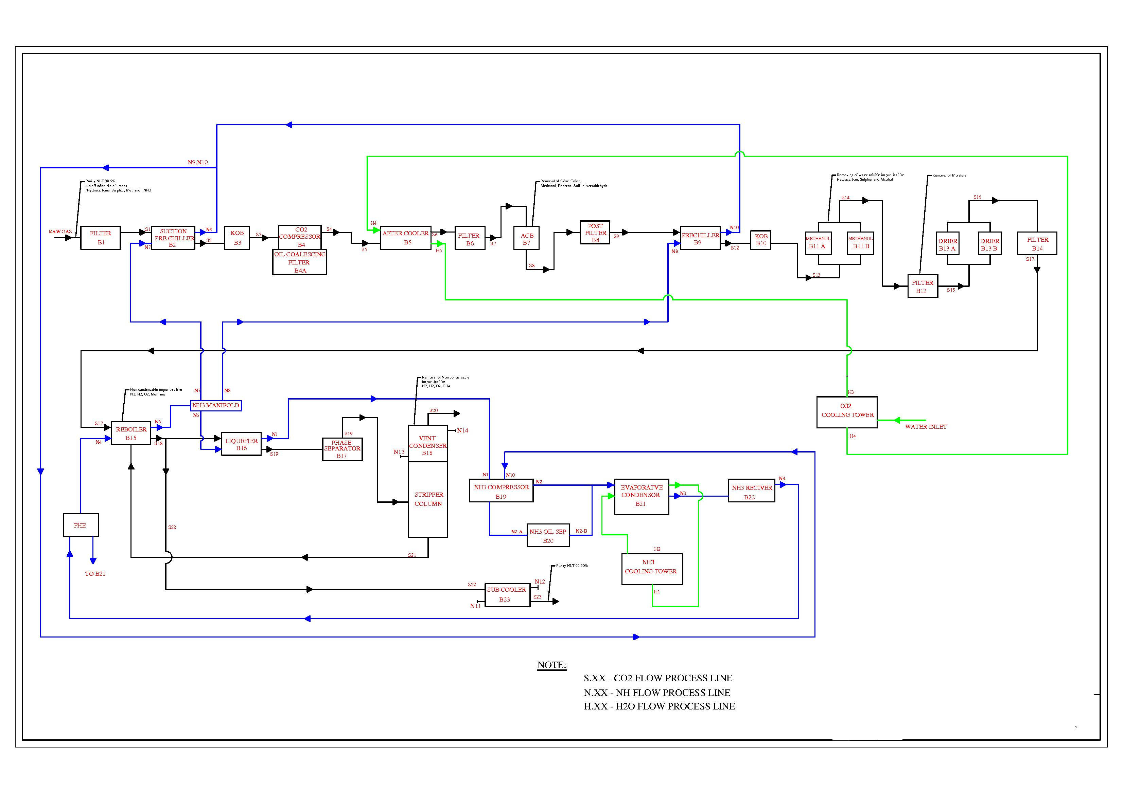
Understanding Scenario
Boiler Architecture inside a chemical plant

Slide 6
Problem Statement
To detect the anomalies of real-time IIot sensors.
To reduce company’s significant time and cost.

Slide 7
Proposed Solution
By collecting data from sensors and applying advanced analytical tools and processes such as machine learning (ML). Predictive maintenance can identify, detect, and address issues as they occur, as well as predict the potential future state of equipment, and so reduce risk. The key is providing the right information at the right time to the right people.

Slide 8
—ARISTOTLE
«WE ARE WHAT WE FREQUENTLY DO.»

Slide 9
02
Process

Slide 10
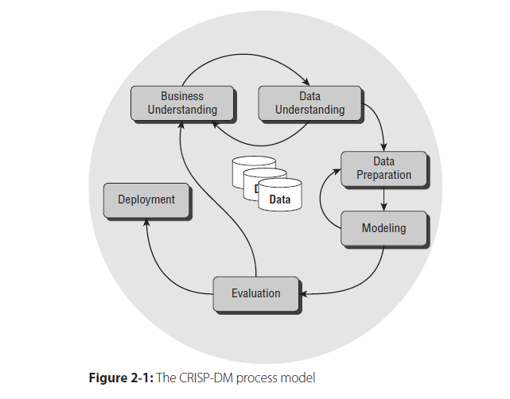
CRISP-DM process
The CRoss Industry Standard Process for Data Mining (CRISP-DM) is a process model that serves as the base for a data science process. It has six sequential phases:
1. Business understanding – What does the business need?
2. Data understanding – What data do we have / need? Is it clean?
3. Data preparation – How do we organize the data for modeling?
4. Modeling – What modeling techniques should we apply?
5. Evaluation – Which model best meets the business objectives?
6. Deployment – How do stakeholders access the results?

Slide 11
1. Business Understanding
The Business Understanding phase focuses on understanding the objectives and requirements of the project.
Objectives are:
Minimizing the time, the equipment is being maintained
Minimizing the production hours lost to maintenance.
Optimizes maintenance activities

Slide 12
2. Data Understanding
In this phase, it drives the focus to identify, collect, and analyze the data sets that can help you accomplish the project goals.
This phase has four tasks:
1. Collect initial data
2. Describe data
3. Explore data
4. Verify data quality

Slide 13
2. Data Understanding
1. Collect initial data
Acquire the necessary data and (if necessary) load it into your analysis tool.
In our project we used csv data and loaded into Jupyter Notebook.

Slide 14
2. Data Understanding
2. Describe Data
Examine the data and document its surface properties like data format, number of records, or field identities.
In our project we have 2160 rows and 16 columns

Slide 15
2. Data Understanding
3. Explore Data
Dig deeper into the data. Query it, visualize it, and identify relationships among the data.

Slide 16
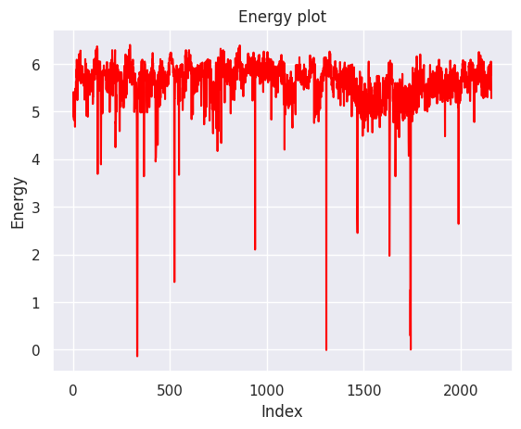
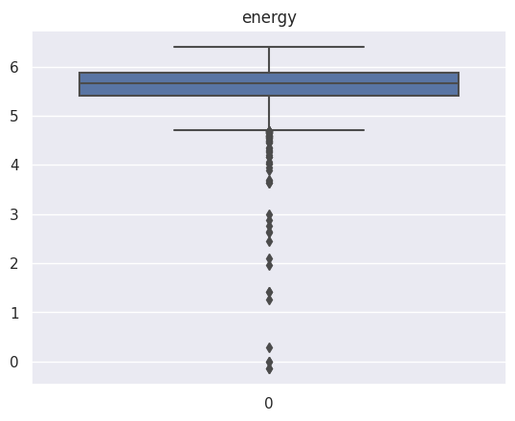
2. Data Understanding

Slide 17
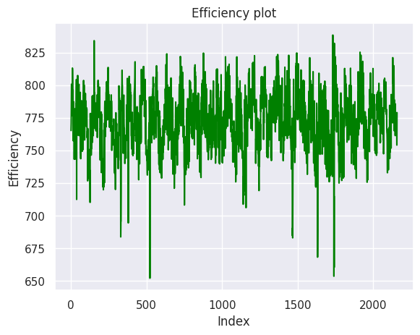
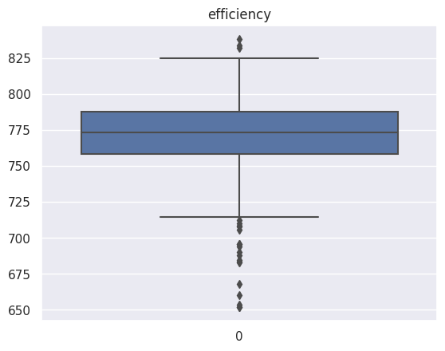
2. Data Understanding

Slide 18
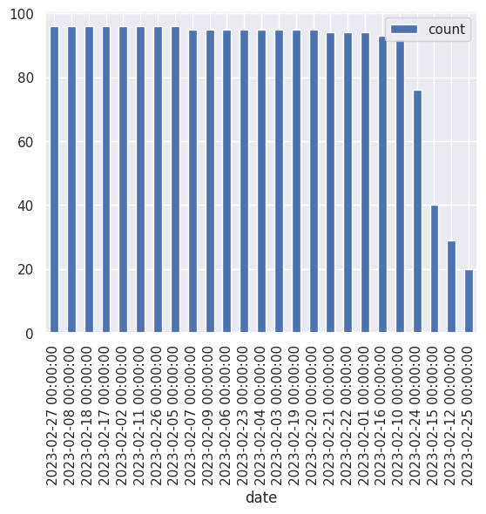
2. Data Understanding
Daily activity of sensors

Slide 19
2. Data Understanding
Paired-T test:
To assess daily sensor performance and detect anomalies, we segmented the sensor data into daily time frames. Paired t-tests were employed to compare daily data with corresponding baseline data, allowing for the detection of subtle variations and anomalies in sensor readings.
Null Hypothesis: Sensor is not working
Alternative Hypothesis: Sensor is working properly

Slide 20
3. Data Preparation
This phase, which is often referred to as “data munging”, prepares the final data set(s) for modeling. It has five tasks:
1. Select data
2. Handle missing values
3. Remove Outliers

Slide 21
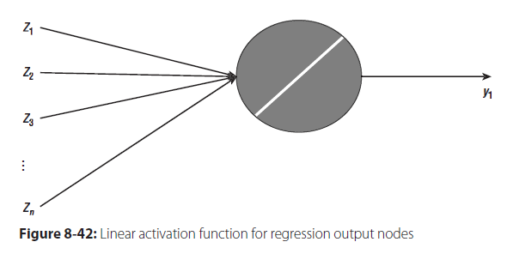
4. Modelling
This phase has four tasks:
1. Select modeling techniques
2. Generate test design
3. Build model
4. Assess model

Slide 22
4. Modelling
Models we used are:
1. Linear Regression
2. Support Vector Regression
3. Random Forest Regressor
4. Decision Tree Regressor
5. Gradient Boosting Regressor
6. K-Nearest Neighbors Regressor
7. Bayesian Ridge Regression

Slide 23
5. Evaluation
Whereas the Assess Model task of the Modeling phase focuses on technical model assessment, the Evaluation phase looks more broadly at which model best meets the business and what to do next. This phase has three tasks:
1. Evaluate results
2. Review process
3. Determine next steps

Slide 24
5. Evaluation
Evaluate results:
Boiler and Best Model
B2, B4, B5, B15: Gradient Boosting Regressor
B16, B23: Linear Regressor
B3: Support Vector Regressor

Slide 25
98%
Average accuracy for each boiler

Slide 26
03
Analysis
Predictive Maintenance

Slide 27
Benefits of PM
Profits
Increase
Heightened
Operator
Safety
Increased
Production
Increased
life span of
machinery
Reduce Maintenace
Costs
Reduced
Downtime
Fewer
Machine
Failures

Slide 28
04
Conclusion
Predictive Maintenance

Slide 29
Inferences
Demonstrated the capability of machine learning algorithms in enhancing predictive maintenance strategies for industrial equipment, particularly in the context of IIoT sensor data.
Achieved a significant improvement in sensor reliability through the developed machine learning algorithm, thereby reducing the likelihood of equipment failures and associated downtime.
Enabled the optimization of maintenance schedules by accurately detecting anomalies in real-time sensor data, allowing for proactive maintenance interventions and minimizing costly unplanned downtime.

Slide 30
Inferences
Enhanced operational efficiency by providing actionable insights derived from the analysis of IIoT sensor data, facilitating informed decision-making processes for maintenance and operational strategies.
Attained a remarkable accuracy rate of nearly 98% for each boiler, underscoring the effectiveness and reliability of the developed machine learning algorithm in detecting anomalies and predicting equipment failures.
Established a foundation for further advancements in predictive maintenance methodologies, paving the way for continued improvements in equipment reliability, operational efficiency, and overall productivity within industrial settings.

Slide 31
Our team
M Bala Shanmugam
Shyam Kumar
Reddy K
Code for this project is: Github (click here)

Slide 32

Thanks!
Contact: kshyamrdy@gmail.com

